Slide 1
Reverse Proxy

Slide 2
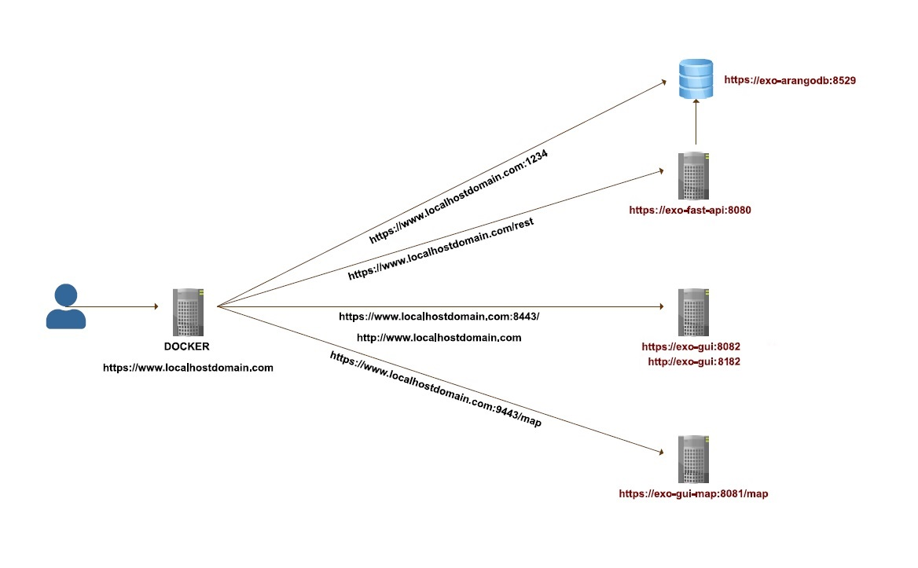
NO PROXY

Slide 3
NO PROXY
Will have to configure all servers for PKI/Cert
How will Auth happen?
Ran into Cross-Origin Resource Sharing (CORS) issues.
Will have to open and expose multiple ports for all services to work.

Slide 4
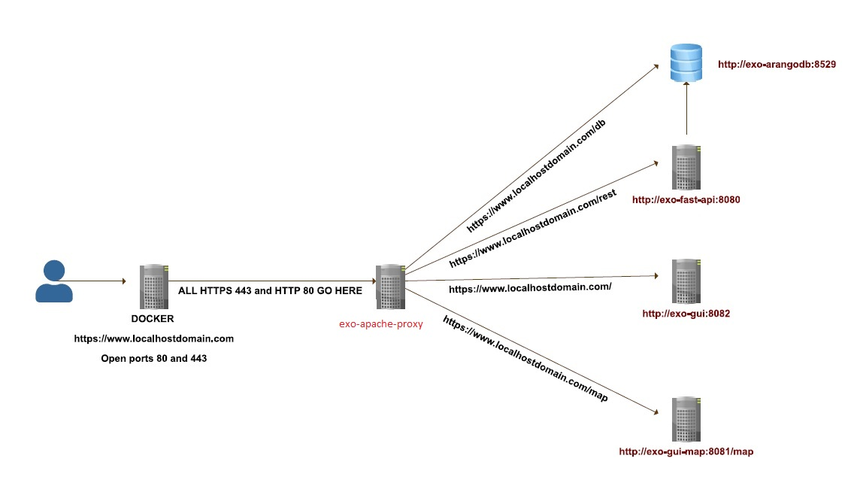
PROXY

Slide 5
PROXY
Configure just the proxy with PKI/Cert, but all connections from the client are secure and HTTPS enabled.
Auth happens at the proxy. If no client cert then no access to anything.
Standard http:80 /https:443 ports open and expose.
Routes are based on path https//:host:port/path.

